Slide 1

Pune Institute of Computer Technology, Pune Dept. of E&TC
304200: Mini Project (MP) (2019 Course)
“Title : Water Level Controller For Purifier”
Guided By: Prof. Sandeep Dhende
By:
1) Shivam Suresh Kabra
2) Narendra Vyankatrao Lungare
3) Pratik Pramod Mirajkar

Slide 2
Aim
The basic function of a water level controller is to regulate water flow and optimize system performance.
One of the main advantages of water level control devices includes the ability to control power fluctuations when the motor is switched on.
Most of these devices ensures uninterrupted water supply by filling the overhead tank once it is below level.
The motor power is switched on when the overhead tank becomes empty and switches off automatically when the overhead tank becomes full.
In this way it becomes easy to ensure 24 hours water supply without any kind of interruption.

Slide 3
Objective
The use of water level control also avoids running the pumps during odd hours, particularly at night.
It also ensures maximum water supply during peak hours especially during morning hours.
The special sensors and time controllers are apt in pumping the water level to its maximum before the peak hours.
It also maintains the water level throughout the day.

Slide 4
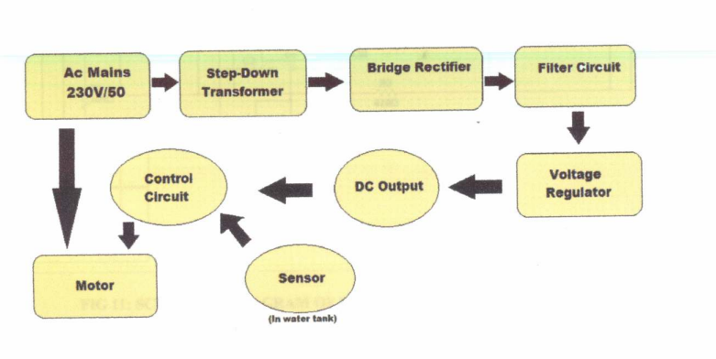
Block Schematic

Slide 5
Explanation of Block Diagram
The Block Diagram consists of-
AC Mains - The AC supply of 230v/50Hz connected to main source.
Stepdown transformer - It is used to stepdown the voltage which is required for the circuit.
Bride Rectifier-The Bridge is consist of four diode which convert the Ac into DC.
Filter circuit - This circuit is used to convert the pulsating DC into pure DC.
Voltage Regulator - It is used to give regulated supply of 5V DC which is need for Controller circuit,
Controller Circuit - This circuit control the motor and Sensor.

Slide 6
Component Selection
COMPONENT | SPECIFICATION | QUANTITY
Metallic Contacts |  | 2
Transformer | 230V,50Hz | 1
Diode | 1N4007,50V | 4
Voltage Regulator IC | MC7805CT | 1
Water Pump | 5W/230V | 1
555 Timer IC | 5V(4.5V-16V) | 1
Triac IC | BT136 | 1
LED | 3-5V | 1
Transistor | BC 548 | 2
Capacitor | 0.01 uF &470 uF | 2
Resistor | 100 Ω and 470 Ω,10 KΩ | 3

Slide 7
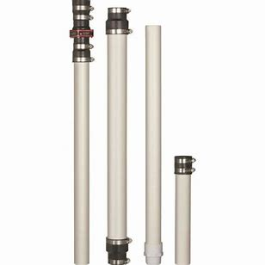
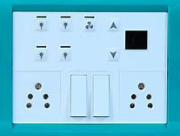
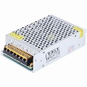
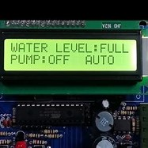
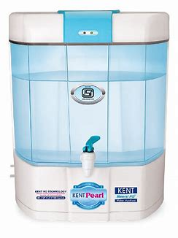

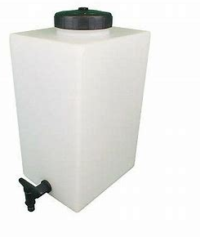
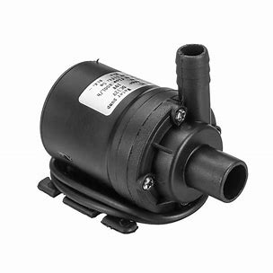
Working model Animation

Slide 8
Features
Automatic: These devices are made to turn on the pump the moment water level falls underneath the predetermined level and turn off once the tank is full. It’s also easy to decide the level of storage by using these products very easily.
Easy to Install: It is extremely simple to install these products in tanks and pools.
Continuous Operation: These controller are very well suited for continuous operation because it consumes less energy in comparison to other kinds of electrical products.
Prevent Overflow: Probably the most significant feature of these products is that it helps you to prevent overflow in the tanks and for that reason helps you to prevent wastages to a large degree.
Power Consumption: It will help to reduce energy consumption because these control the amount of water in tanks and other spaces easily. Consequently you’ll be able to avoid wastage of both energy and water which will be quite advantageous in the current scenario.

Slide 9
Future Scope
The basics need of human being is water and it is one of the most important necessary for all living beings.
But unfortunately a huge amount of water is being wasted by uncontrolled use and due to our negligence.
Some other automated water level monitoring system is also offered so far but most of the method has some shortness in practice.
We tried to overcome these problems and implemented an efficient automated water level monitoring and controlling system for purifier.
Main intension of this research work is to establish a flexible, economical and easy configurable system which can solve water losing problems

Slide 10
Resources required
https://www.electronicshub.org/water-level-controller-using-8051- microcontroller/
https://youtu.be/tYwQTTG-GDg
https://www.tutorialspoint.com/microprocessor/microcontrollers_8051_architec ture.html
https://www.electronicsforu.com/resources/learn-electronics/16x2-lcd-pinoutdiagram
https://www.instructables.com/id/All-You-Need-to-Know-About-Relays/
https://www.alldatasheet.com/datasheet-pdf/pdf/11551/ONSEMI/BC547.html
http://www.circuitstoday.com/water-level-controller-using-8051
https://m.indiamart.com/impcat/submersible-pumps.html
http://www.circuitstoday.com/5v-power-supply-using-7805

Slide 11
Thanks

